Slide 1
The Impact of Large Language Models (LLMs) on MT: A European view
Kenneth Church
k.church@northeastern.edu

Slide 2
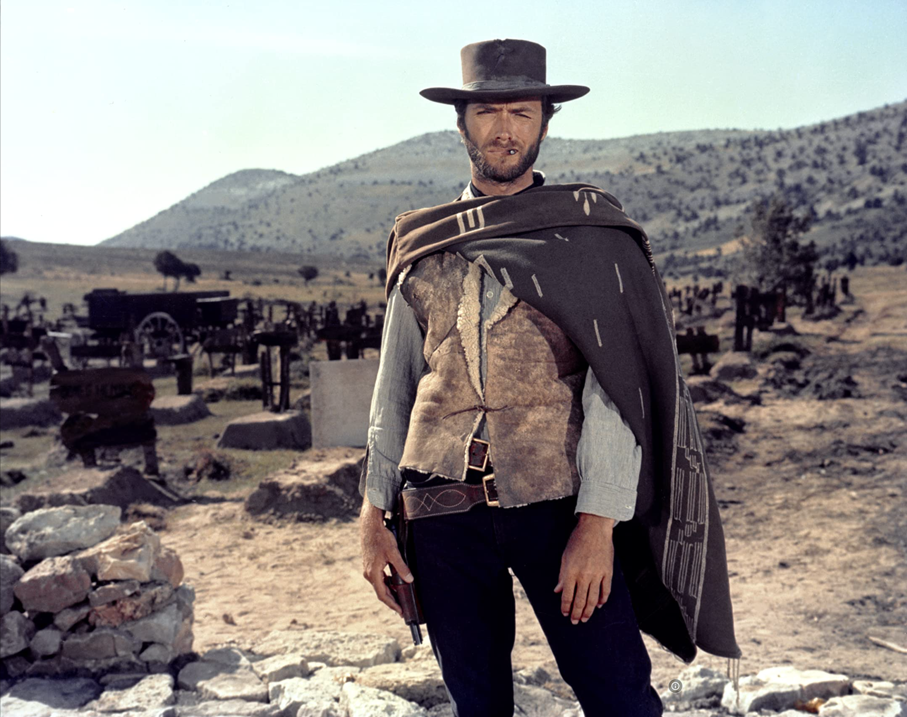
Disclaimer from an Ugly American… (The Good, the Bad and the Ugly)
This meeting reminds me of a meeting in Paris in 1995
Comparing NLP funding in America with European Community
America: funding → defense
Europe: funding → community
At that time, there were concerns about web
Would WWW be bad for French?
In retrospect,
Web has been good for languages, big and small
In general,
Technology → Change (for better and for worse)
Tech has upsides and downsides (and worse)

Slide 3

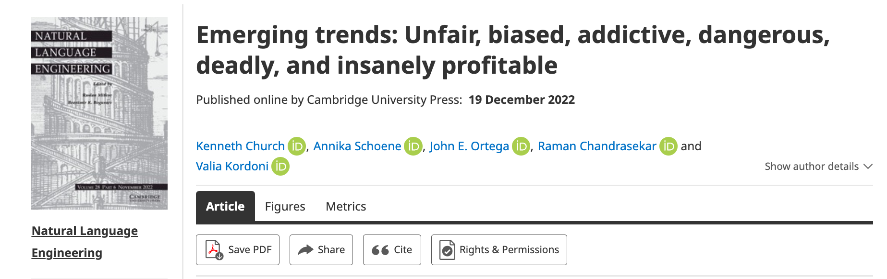
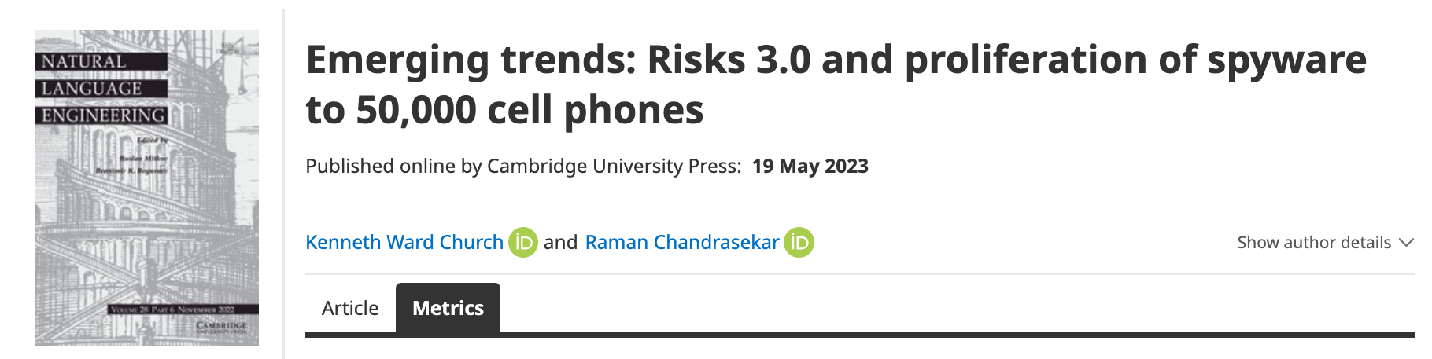
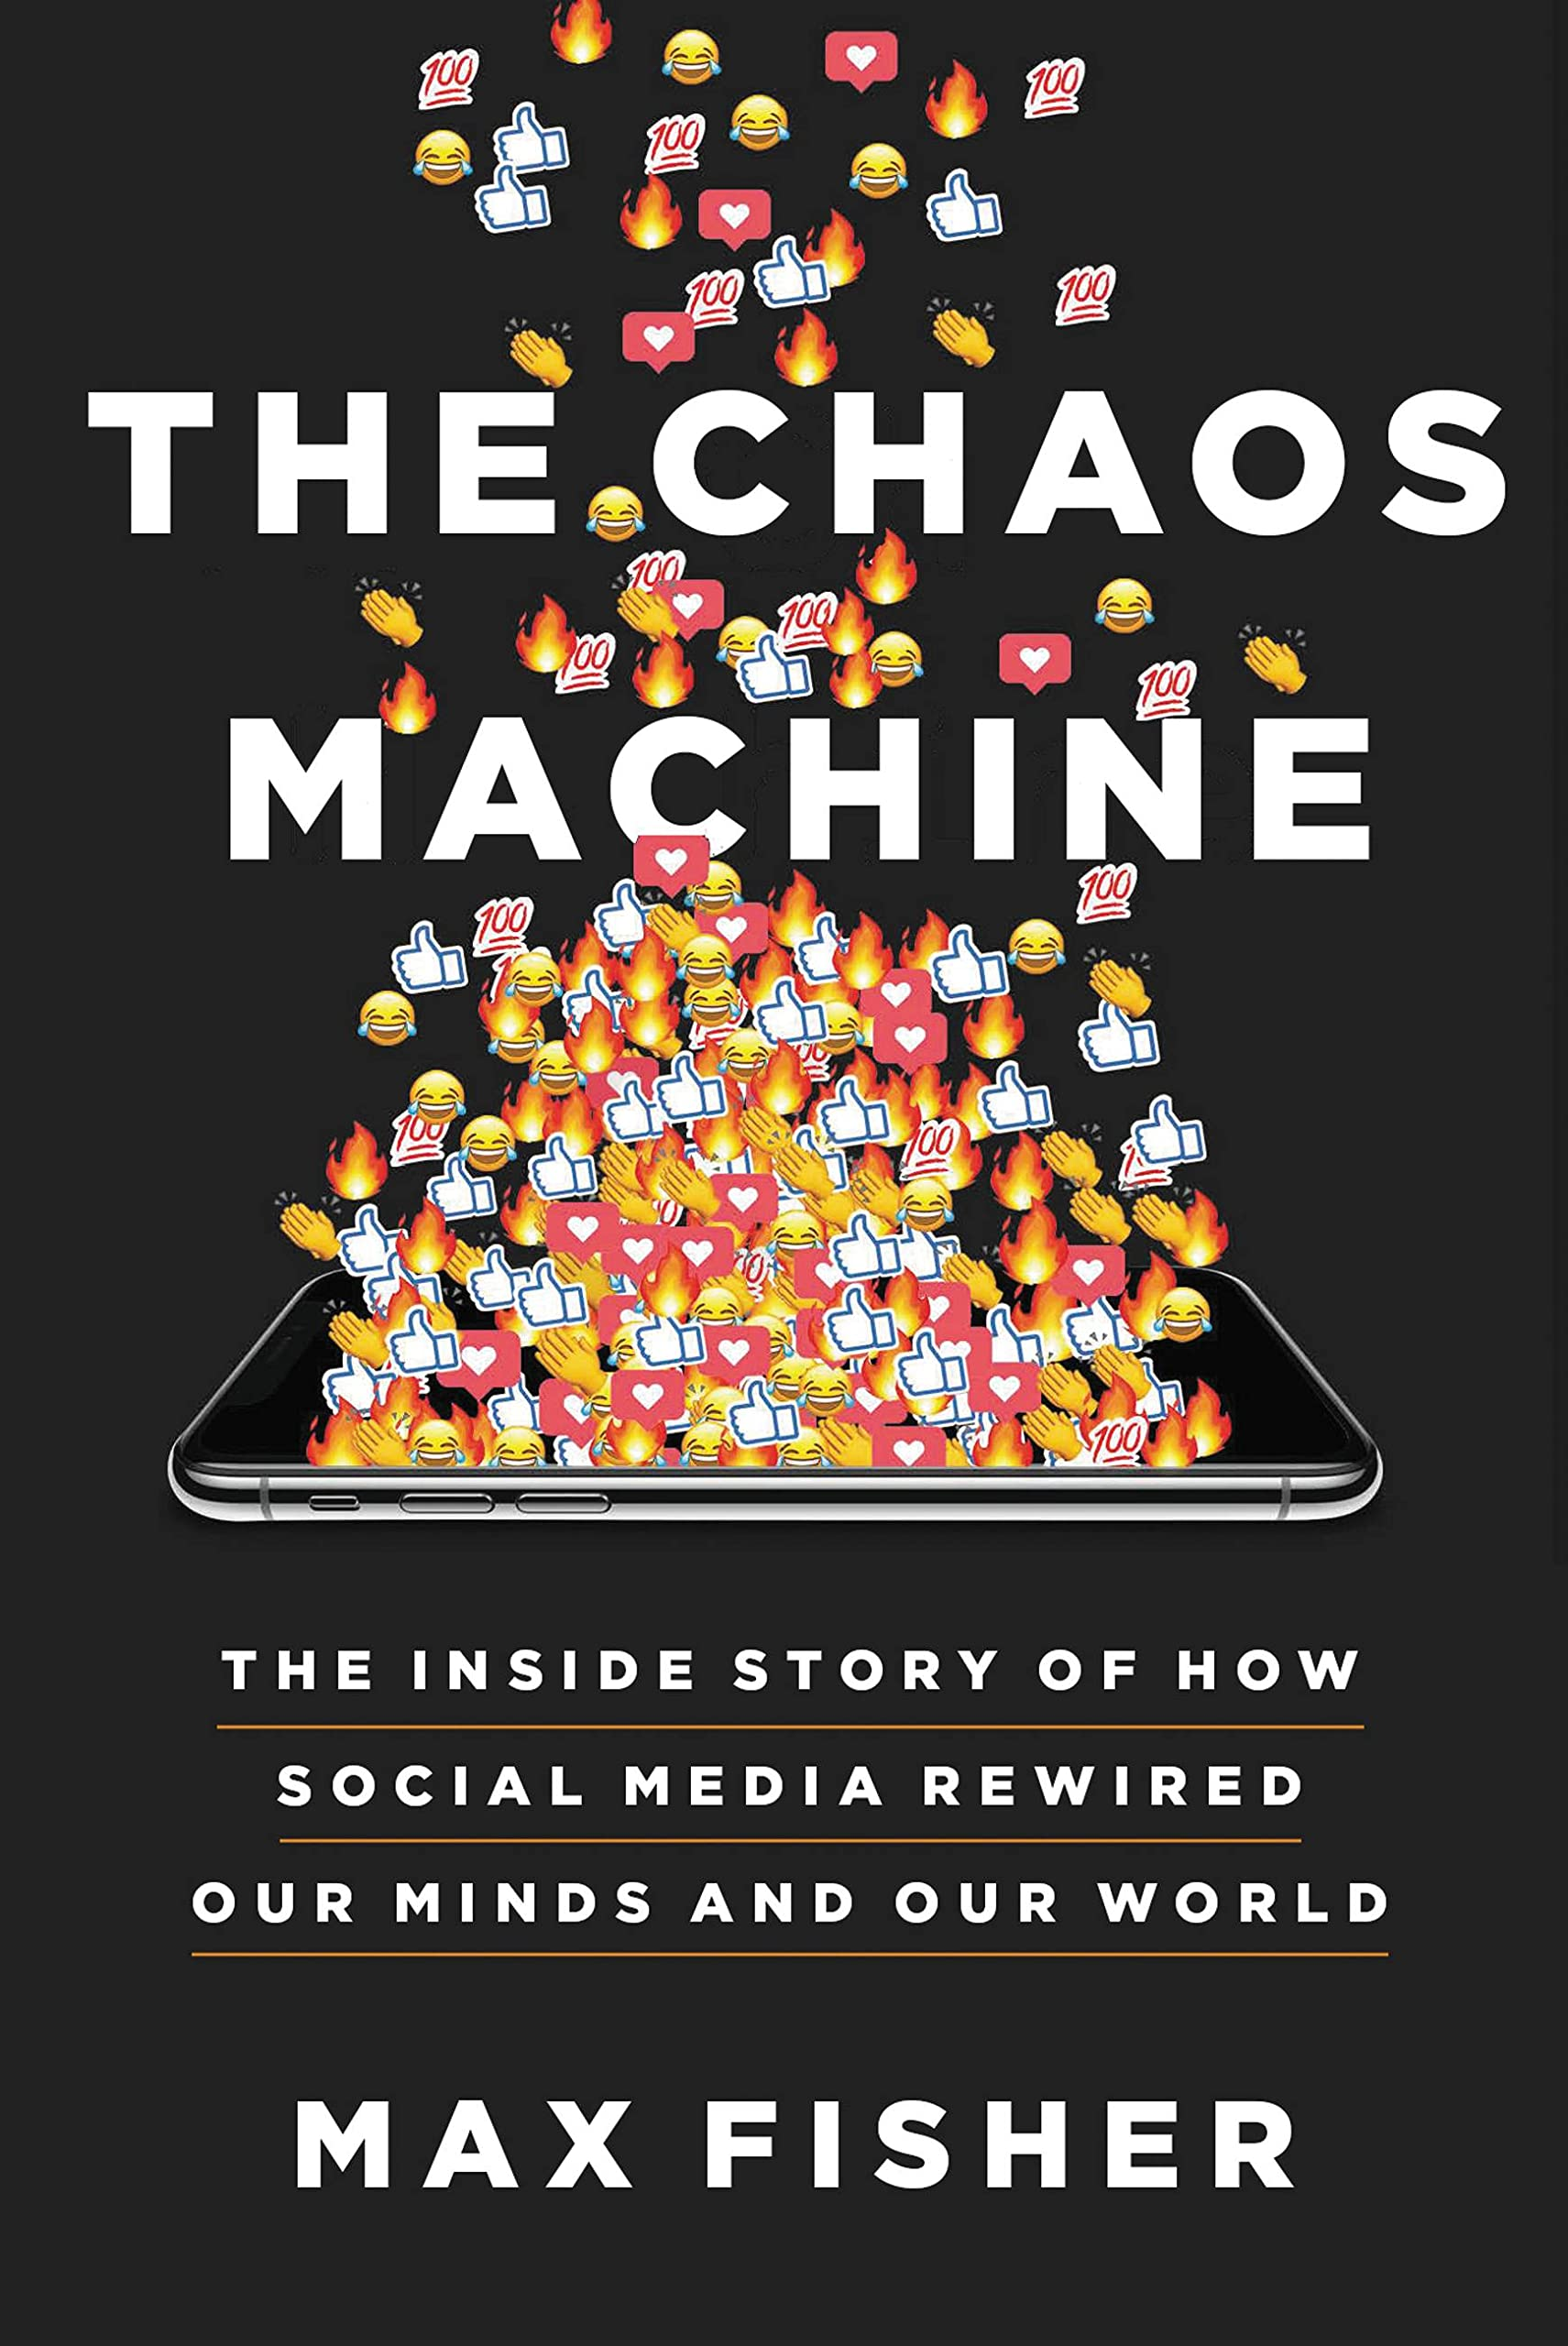


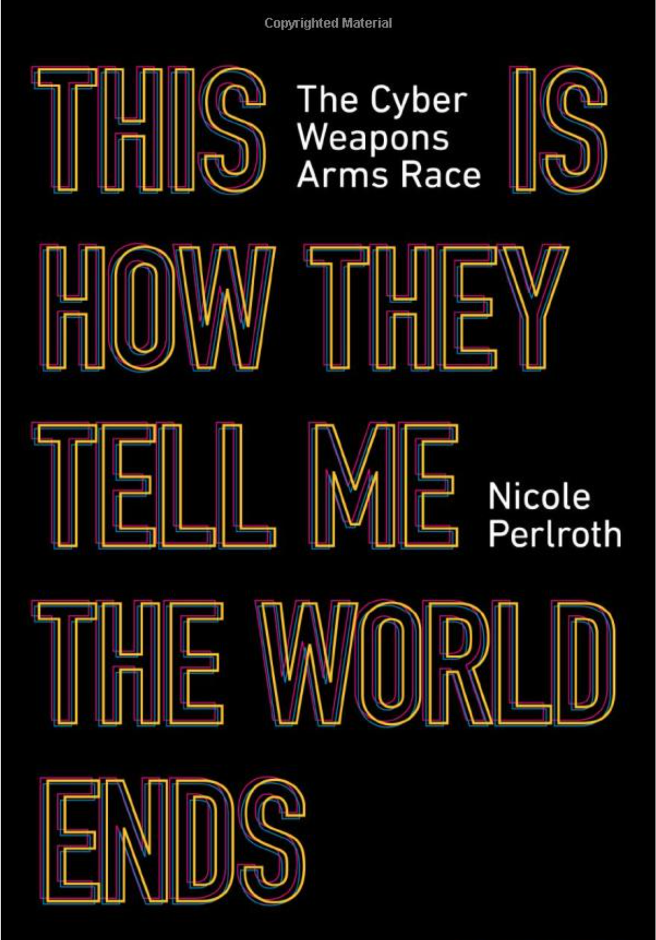

Ugly: Responsible AI
Incentives matter
Risks 1.0 (2016)
Unfair, Biased
Risks 2.0 (2022)
Addictive, dangerous, deadly
and insanely profitable
Risks 3.0 (2023)
Malware
Spyware
Challenge for Regulation
Business case $≠$ Public Interest (Health, National Security)
Tobacco companies maximize sales; ditto for fast food & junk food
Risks 2.0 (Toxicity): Good for social media companies; we ❤️ click bait
Risks 3.0 (Conflict): Good for defense industry

Slide 4
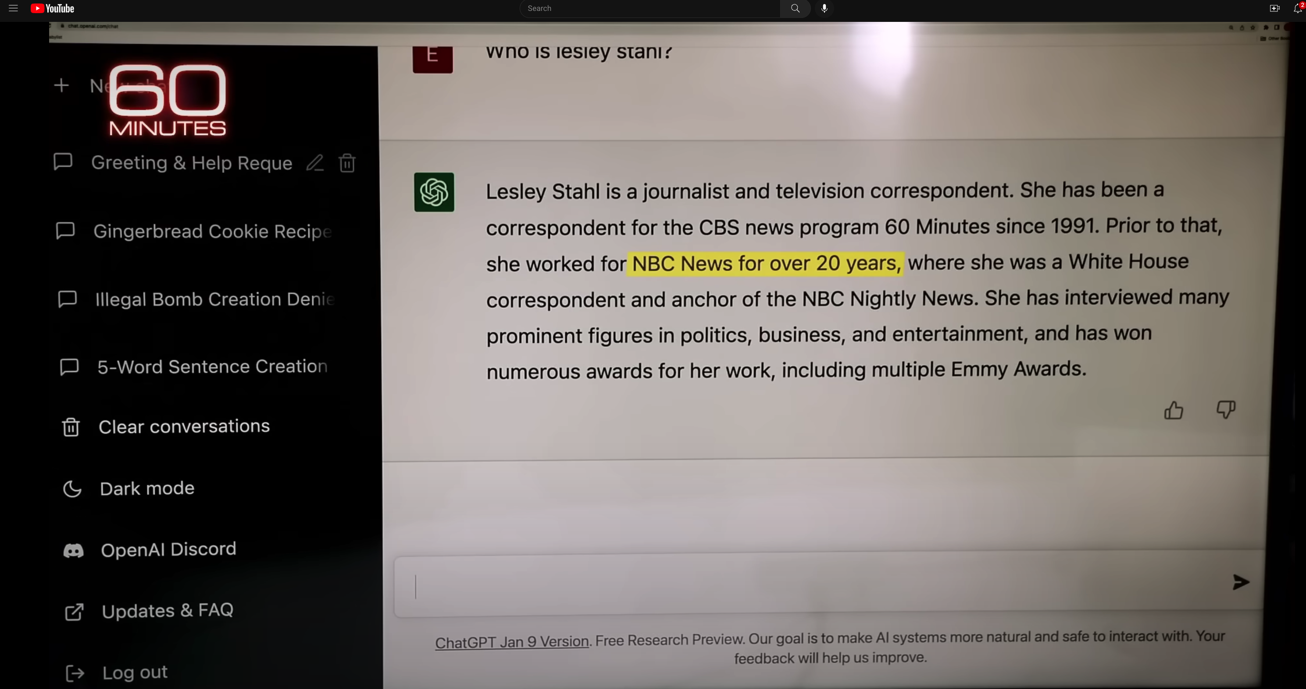
Hallucinations
Prompt
Language models
make up ``alternative facts’’
faster than fact-checking
Dangerous failure mode
People will believe these ``alternative facts’’
Hallucination
ChatGPT Hallucinates on CBS ``60 Minutes’’ https://www.youtube.com/watch?v=1wzPr4cUoMQ&t=463s
https://github.com/kwchurch/ACL2022_deepnets_tutorial
4

Slide 5
Positive Opportunities for Machine Translation
Technology is good enough
that I could work for Baidu
even though my Chinese
is worse than my French
Functionality
Inputs: language → phones
camera, microphone, QR codes, net
documents (html, pdf, ppt, xls)
Outputs: phones → language
screen, speaker, net, etc.
Requirements: fluency, credibility, latency
Widely deployed (in China)
Everywhere: Hotels, taxis, shops, etc.
Anyone with a phone (everyone)
Knows how to use this stuff
Metrics suggest
Technology is better than humans
But I am more productive
with a human interpreter
Metrics are wrong: BLEU & latency
Human interpreters emphasize
What I need to know
When I need to know it
Machines translate
Everything (with equal emphasis)
I don’t trust machines (with terminology):
``ecology’’ vs ``eco-system’’
``corruption’’
It is exhausting second-guessing machines

Slide 6
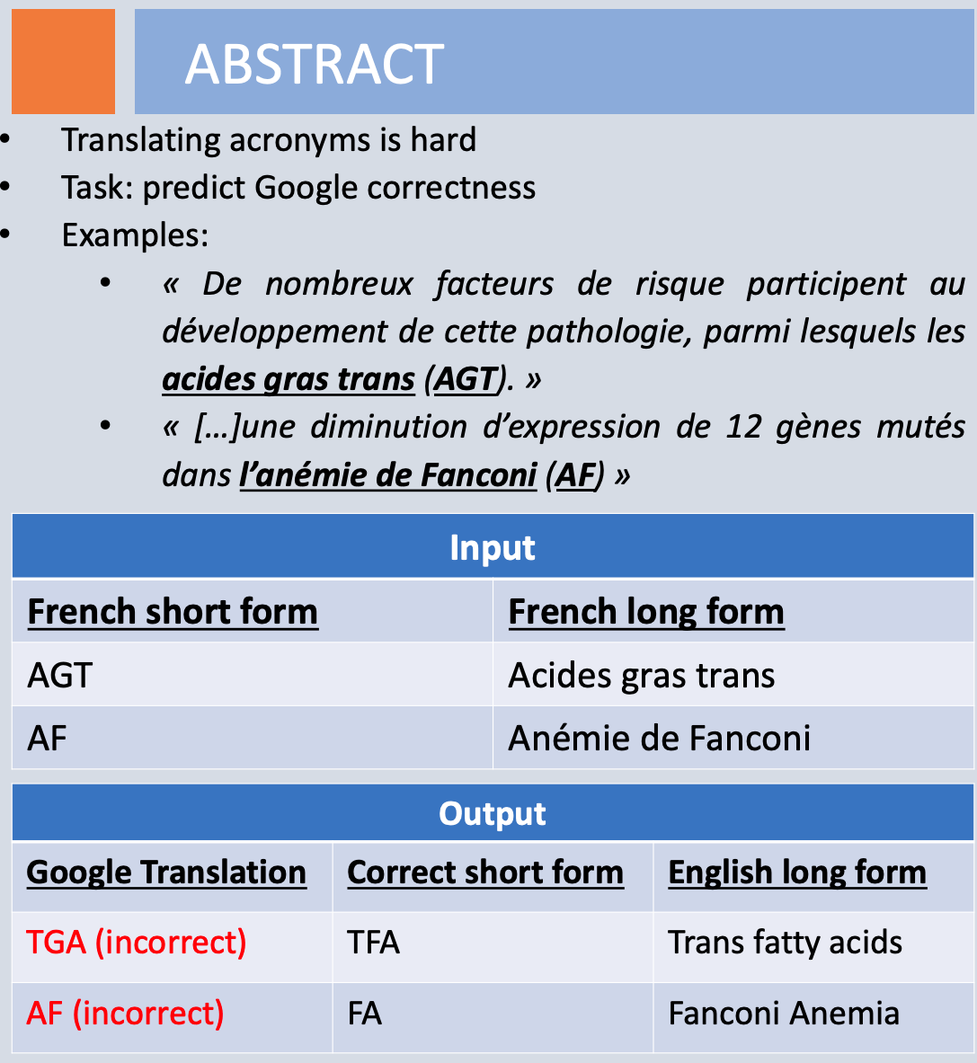
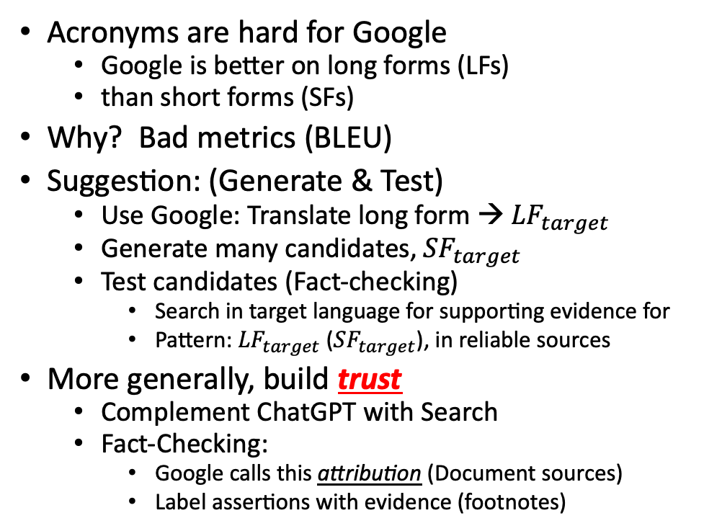
Mismatch Between Translators & Engineers: Technical Terminology
Richard Yue
Acronyms are hard for Google
Google is better on long forms (LFs)
than short forms (SFs)
Why? Bad metrics (BLEU)
Suggestion: (Generate & Test)
Use Google: Translate long form → ${LF}_{target}$
Generate many candidates, ${SF}_{target}$
Test candidates (Fact-checking)
Search in target language for supporting evidence for
Pattern: ${LF}_{target}$ (${SF}_{target}$), in reliable sources
More generally, build trust
Complement ChatGPT with Search
Fact-Checking:
Google calls this attribution (Document sources)
Label assertions with evidence (footnotes)
Hallucinations

Slide 7
backup

Slide 8
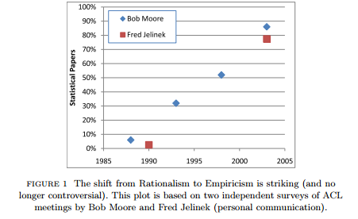
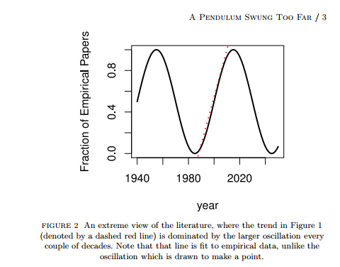
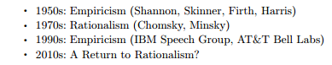
History: Pendulum Swung Too Far
⚠️ ⚠️ ⚠️ Warning ⚠️ ⚠️ ⚠️
Unrealistic Expectations → Winter
Mechanism
⚠️ ⚠️ ⚠️ Warning ⚠️ ⚠️ ⚠️
Unrealistic Expectations → Winter

Slide 9
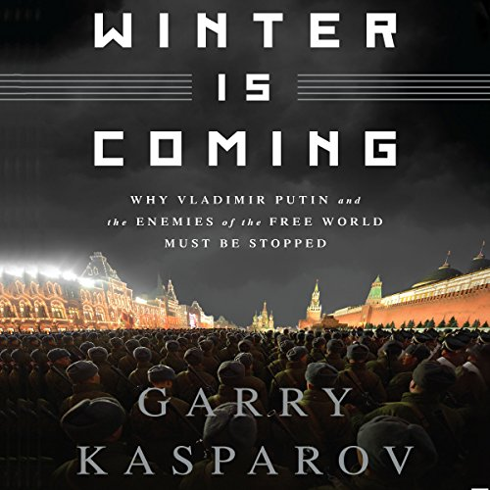
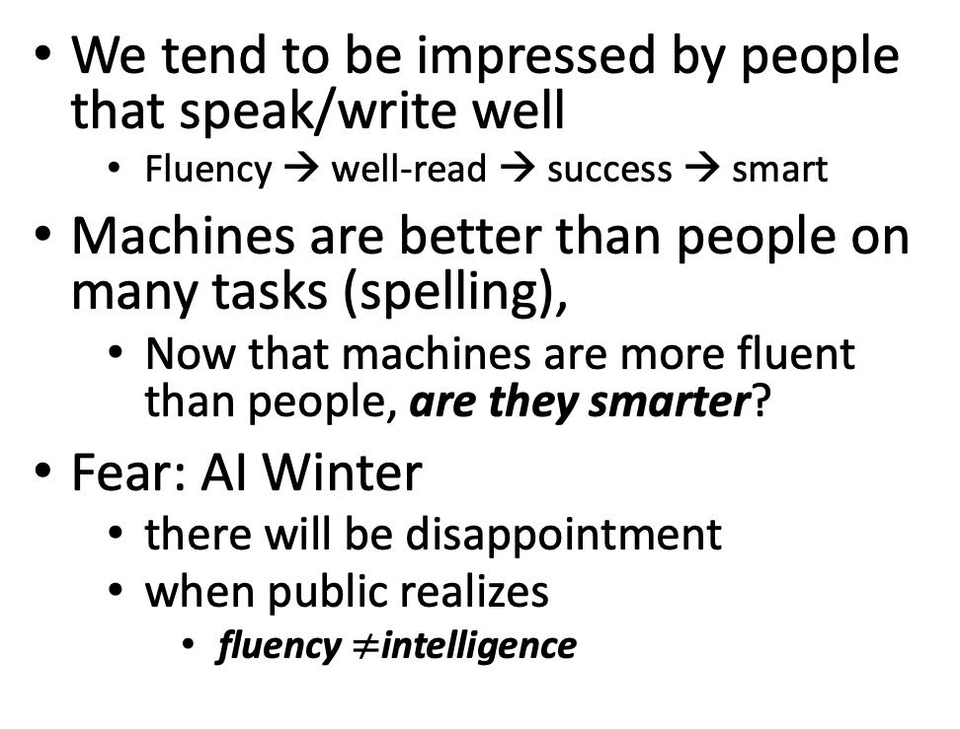
Winter is Coming
We tend to be impressed by people that speak/write well
Fluency → well-read → success → smart
Machines are better than people on many tasks (spelling),
Now that machines are more fluent than people, are they smarter?
Fear: AI Winter
there will be disappointment
when public realizes
fluency $≠$intelligence
Pendulum Swung Too Far
There have been many AI Winters
Often, after ``irrational exuberance’’
(like current excitement with nets)

Slide 10
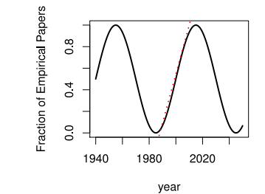
Large Language Models (LLMs) Strengths (1950s/1990s); Weaknesses (1970s)
Easy
Easy
Strengths (fluency)
1950s/1990s: Empiricism
Shannon, Skinner, Firth, Harris
You shall know a word by the company it keeps (Firth, 1957)
Collocations (Easy for Machines)
Distributional Hypothesis (Zellig Harris):
PMI, Word2Vec, BERT
No ``hard’’ stuff
Weaknesses (Hallucinations)
1970s: Rationalism (``Hard’’ Stuff)
Chomsky, Minsky
Truth: logic, possible worlds
Meaning
Purpose (Gricean Maxims)
Common Sense
Hard

